Slide 1
Embedding comparison of BERT and ChatGPT answers of «General Knowledge» dataset

Slide 2
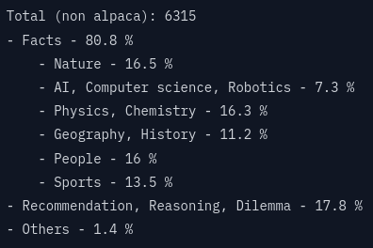
General Knowledge dataset
A set of ~38000 questions and answers.
Is meant to be used for model training.
e.g.: {
'Question': 'What is the largest species of shark',
'Answer': 'The whale shark is considered the largest species of shark, with adults reaching lengths of up to 40 feet or more and weighing several tons.'
}
https://huggingface.co/datasets/MuskumPillerum/General-Knowledge

Slide 3
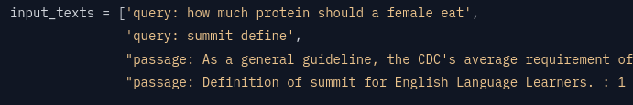
E5 small v2 model
Text Embeddings model
Model has 12 layers.
https://huggingface.co/intfloat/e5-small-v2
Input texts have to be labeled with query and answer:

Slide 4
GPT API Querys
Querys have been done with «gpt-4o» model.
Threading & async.
Delay had to be implemented for «Rate limit exceeded».

Slide 5
GPT API Querys
First try: $12 used within 20min then connection lost. No data saved.
Second try: much slower queries, data streamed to csv continuously. Script interrupted after hours and only 743 answers received.
Total of $32 spent.

Slide 6
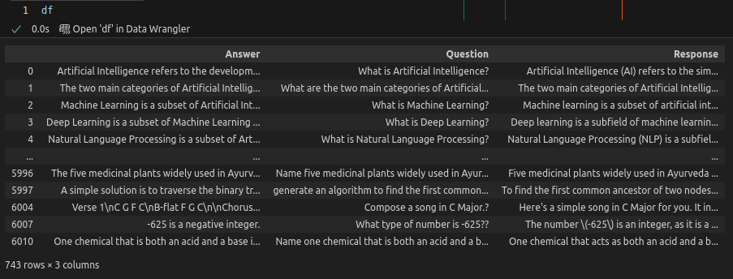
Dataset merged
The responses from GPT4o have been merged back with the dataset and the dataset was reduced with .dropna()

Slide 7
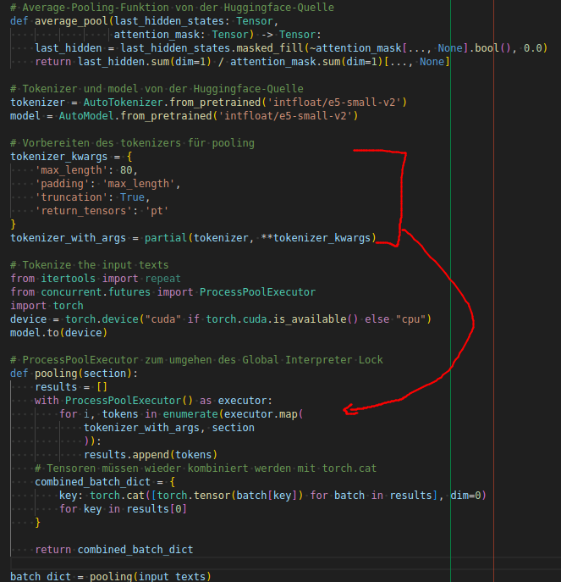
Embedding
Average pooling as suggested by huggingface.
Multiprocessing was necessary to avoid out-of-memory error.
torch.cat() for concatenation of the tensors.

